Slide 1
ELG 5255 : Applied Machine Learning
Course Instructor: Prof. Hitham Jleed

Slide 2
Predictive Analysis of IPL Match Outcomes using Machine Learning Algorithms
Semester: Fall 2023
Dataset : IPL Complete Dataset (2008-2020)

Slide 3

Group Member:
Bansari Patel – 300342847

Slide 4
Content:
Introduction
Objectives
Dataset Overview
Data Cleaning and Preprocessing
Exploratory Data Analysis (EDA)
Feature Selection
Problem Statements
Model Selection
Model Training
Model Evaluation
Results
Conclusion

Slide 5

Introduction:
A premier cricket league
Launched in 2008 By the Board of Control for Cricket in India (BCCI)
Introduced an exciting Twenty20 format

Slide 6
Objectives
Build a comprehensive IPL dataset
Data preprocessing
Exploratory Data Analysis (EDA)
Feature engineering
Model development

Slide 7
Dataset Overview:
Ball-by-ball data of IPL from 2008-2020
Approximately 193k rows of data
Attributes
Nominal Attributes (Encoded attributes included):
i.e. Match Id, Batsman, Non striker, Bowler, Batting team, Bowling team
Ordinal Attributes:
i.e. Over, Ball, Batsman runs, Total runs, Extra runs
Binary:
i.e. Inning, Wicket, Non boundary

Slide 8
Data Cleaning and Preprocessing:
Encoding of attributes:
Label encoding of categorical variables, player names
Encoding of Ordinal variables
Handling missing values and Outliers:
Removed some rows if the proportion was very low
Replaced them with appropriate values
Normalization OR Scaling:
Min-Max scaling

Slide 9
Exploratory Data Analysis (EDA):
Runs distribution
Ball wise
Player wise
Explored relationships with other factors
Correlation Analysis
Examined player roles and impact on performance
Batsman
Bowler

Slide 10
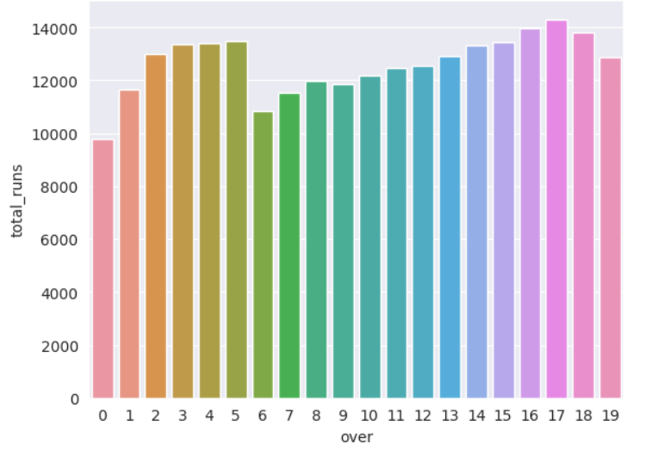
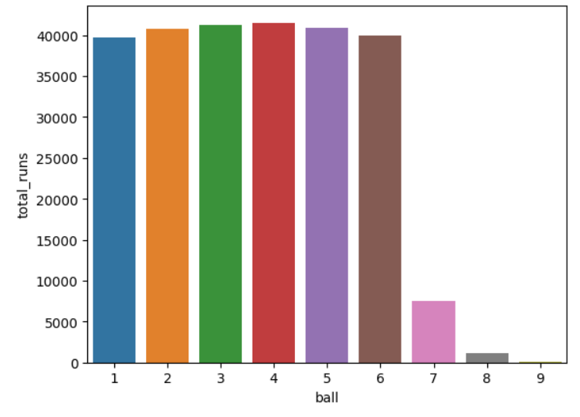
Exploratory Data Analysis (EDA):
Over Wise Runs
Ball Wise Runs
ELG 5255 Final Presentation

Slide 11
Feature engineering:
Season Wise Boundaries:
Analysis of 4s and 6s
Batting Strike Rate:
Calculated as runs scored divided by balls faced.
Runs per Inning :
Calculated by dividing total runs by the number of innings played
Players Achievements :
Calculated total half-centuries and centuries scored by the player

Slide 12
Model Selection:
Clustering of the players in Batsman, Bowler and All-rounder
K-means Clustering
Predicting runs of a player from past performances in future
Linear Regression
Linear Regression Variants
With Gradient Descent
With Custom Gradient Descent
Ridge Regression

Slide 13
Model training and Evaluation:
K-Means Clustering
2 Attributes: Runs Scored, Wickets taken
Optimal K: Elbow method (k = 3)
Scaling: Min-Max Scaler
Model: sklearn.cluster.KMeans
Plot: Scatter plot from matplotlib
K-Means Clustering
7 Attributes: batting innings, bowling innings, high score, best spell, batting average + 2
Scaling: Min-Max Scaler
Model: sklearn.cluster.KMeans
Plot: Scatter plot from matplotlib

Slide 14
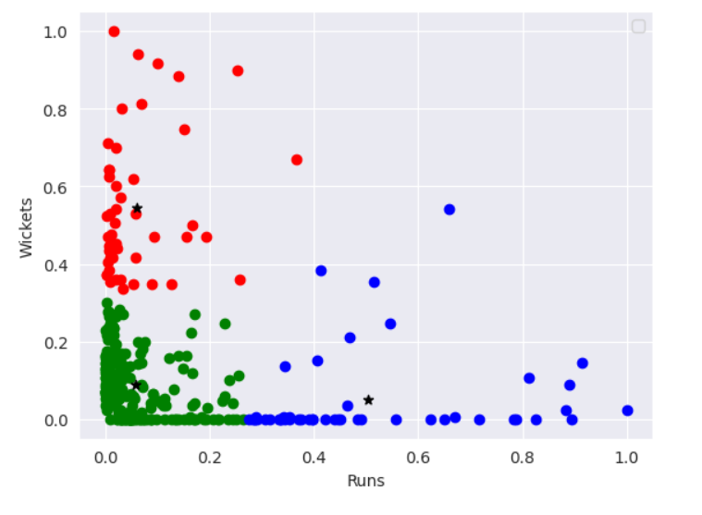
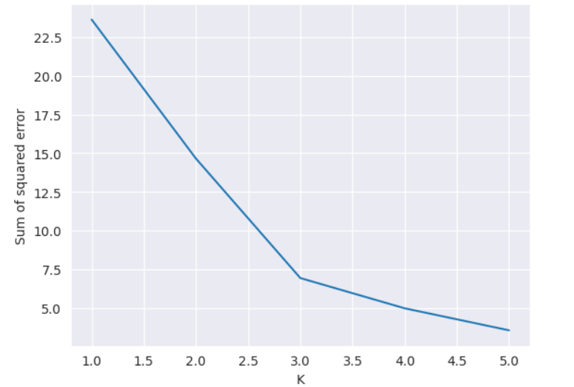
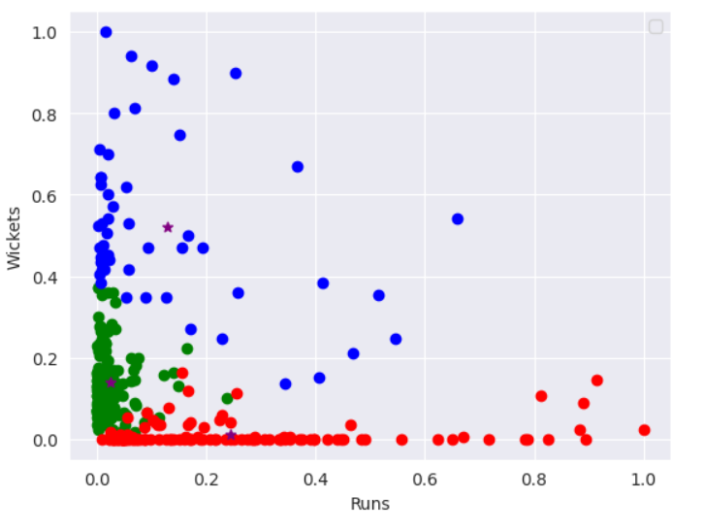
For 2 Attributes
For 7 Attributes

Slide 15
Model training and Evaluation:
Linear Regression (Implicit Parameters)
Attributes: Batsman id, balls_faced, innings, runs, num of 4s, num of 6s, average runs, strike rates, centuries, half centuries
Target Variable: Runs in future matches
Train test split: 80% train , 20% Test
Model: sklearn.linear_model.LinearRegression
Evaluation Measures
RMSE: 3.88
R-squared: 0.69
ELG 5255 Final Presentation

Slide 16
Model training and Evaluation:
Linear Regression (Gradient Descent)
Attributes: Batsman id, balls_faced, innings, runs, num of 4s, num of 6s, average runs, strike rates, centuries, half centuries
Target Variable: Runs in future matches
Train test split: 80% train , 20% Test
Model: sklearn.linear_model.SGDClassifier
Evaluation Measures
RMSE: 28.31
MAE: 4.19
ELG 5255 Final Presentation

Slide 17
Model training and Evaluation:
Linear Regression (Custom Gradient Descent)
Attributes: Batsman id, balls_faced, innings, runs, num of 4s, num of 6s, average runs, strike rates, centuries, half centuries
Target Variable: Runs in future matches
Train test split: 80% train , 20% Test
Model: sklearn.linear_model.SGDClassifier
Hyperparameter Tuning: Grid Search (Alpha)
Evaluation Measures
RMSE: 36.60
MAE: 4.88
ELG 5255 Final Presentation

Slide 18
Model training and Evaluation:
Ridge Regression (Regularized Linear Regression)
Attributes: Batsman id, balls_faced, innings, runs, num of 4s, num of 6s, average runs, strike rates, centuries, half centuries
Target Variable: Runs in future matches
Train test split: 80% train , 20% Test
Model: sklearn.linear_model.Ridge
Evaluation Measures
RMSE: 16.68
MAE: 2.99
ELG 5255 Final Presentation

Slide 19
Results
Linear Regression (Implicit)
RMSE: 3.88
1
Ridge Regression
(Regularization)
RMSE: 16.68
2
Gradient Descent
(Implicit)
RMSE: 28.31
3
Custom Gradient Descent
RMSE: 36.60
4
ELG 5255 Final Presentation

Slide 20
Conclusion
Data Mastery:
Successfully preprocessed and transformed IPL ball-by-ball data for analysis.
Insightful Clustering:
Utilized unsupervised clustering to categorize players into batsmen, bowlers, and all-rounders.
Feature Engineering Impact:
Engineered features, incorporating player form and match conditions, to enhance model predictive power
ELG 5255 Final Presentation

Slide 21
Any Questions?!

Slide 22
Thank You!!

